Slide 1
UTILITY USAGE PREDICTION TOOL
Machine Learning Based Console Application
Presented By:
Siddhi Mohite
Internship:
CodeVedX AI/ML Virtual Internship
Submission Year: 5 June 2026

Slide 2

Introduction
The Utility Usage Prediction Tool is a Machine Learning-based console application developed using Python.
The system helps users:
Manage utility usage records
Store data using CSV files
Update existing records
Predict utility consumption
Handle invalid inputs efficiently
The project demonstrates practical implementation of Python programming, file handling, and machine learning concepts.

Slide 3
Problem Statement
Manual management of utility usage records can be time-consuming and error-prone.
Challenges include:
Maintaining accurate records
Tracking usage patterns
Predicting future consumption
Managing large amounts of data efficiently
There is a need for a system that can automate record management and provide intelligent predictions using Machine Learning.

Slide 4
Project Objectives
Develop a menu-driven console application
Implement CSV file handling
Store and manage utility usage records
Train a machine learning model
Predict utility consumption
Improve data analysis and decision-making

Slide 5
Technologies Used
Technology | Purpose
Python | Core Programming
Pandas | Data Processing
CSV Files | Data Storage
Scikit-Learn | Machine Learning
Joblib | Model Saving & Loading
VS Code | Development Enviroment

Slide 6
Project Structure
Utility_Usage_Prediction_Tool
│
├── data
│ └── utility_usage.csv
│
├── models
│ └── utility_model.pkl
│
├── src
│ ├── data_handler.py
│ ├── predictor.py
│ └── train_model.py
│
└── main.py
Description
main.py → Main application interface
data_handler.py → Manage records
train_model.py → Train ML model
predictor.py → Generate predictions
utility_model.pkl → Saved ML model

Slide 7

Machine Learning Model
Machine Learning Implementation
The project uses a trained Linear Regression model to predict utility usage.
Input Parameters
Temperature
Number of Residents
Output
Predicted Utility Usage
Example
Temperature: 30°C
Residents: 5
Predicted Utility Usage: 275.43 Units

Slide 8
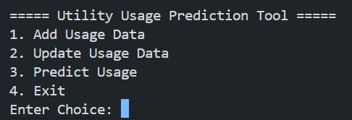
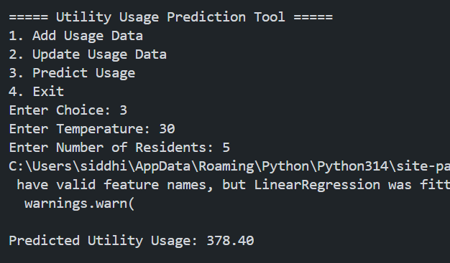
Results & Output
The main menu provides a user-friendly interface that allows users to add utility usage records, update existing data, generate predictions, and exit the application.
The machine learning model analyzes the input parameters, such as temperature and number of residents, and generates an estimated utility usage value. This demonstrates the predictive capability of the system.
Result: The Utility Usage Prediction Tool successfully manages utility usage records, stores data in CSV format, and generates utility consumption predictions using a trained machine learning model. The system operates efficiently through a menu-driven console interface and handles user inputs effectively.

Slide 9
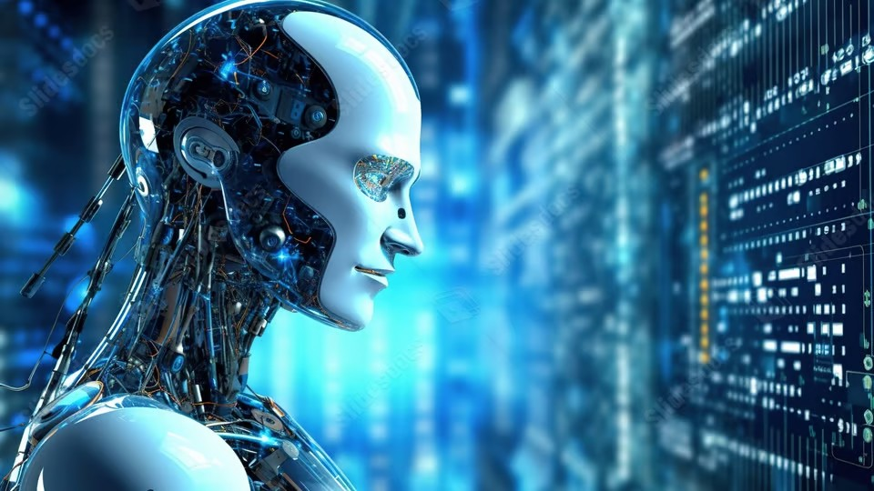
Challenges & Future Scope
Challenges Faced
Understanding Machine Learning workflow
Managing CSV file operations
Handling user inputs
Integrating trained models
Future Scope
GUI-based application
Database integration
Web deployment using Flask
Advanced ML algorithms
Real-time utility monitoring

Slide 10
Conclusion
The Utility Usage Prediction Tool successfully demonstrates:
Python Programming
CSV File Handling
Machine Learning Integration
Data Management
Exception Handling
The project provides an efficient solution for storing utility records and predicting future utility consumption using historical data.

